Slide 1
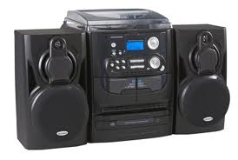
MAGNASONIC
Mini Stereo Hi Fi Audio System
With 3-CD Changer and Turntable
3 CD Changer
Built-in turntable
Wooden Speakers
MS878

